Slide 1

Air Quality Forecast Challenge
V. Gillioz, C. Sicard, K. Pyszkowski
17.05.2021

Slide 2
Agenda
Data Pipeline
Data Visualization
Data Preprocessing
Forecasting PM2.5 Time Series Using a Recurrent Neural Network
Comparison of Our Model with Other Time-Series Forecasting Methods
Data Prediction using Fast Fourier Transform
Data Prediction using Facebook Prophet
Data Prediction using SARIMA
Conclusion

Slide 3
1. Data Pipeline

Slide 4


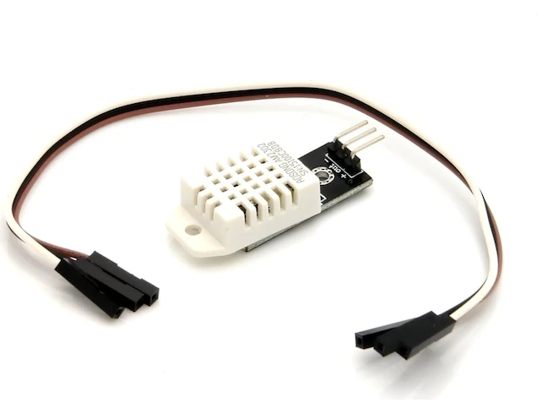
Setup of Data Pipeline
Measurements by SPS30 and DHT22 sensors on a Raspberry Pi
Python interface for analysis and visualization
Thingspeak IoT
Every 5 minutes :
1 measurement is made
Saved on Raspberry Pi in CSV format
Uploaded on Thingspeak IoT
But it after 6 days it stopped working…

Slide 5
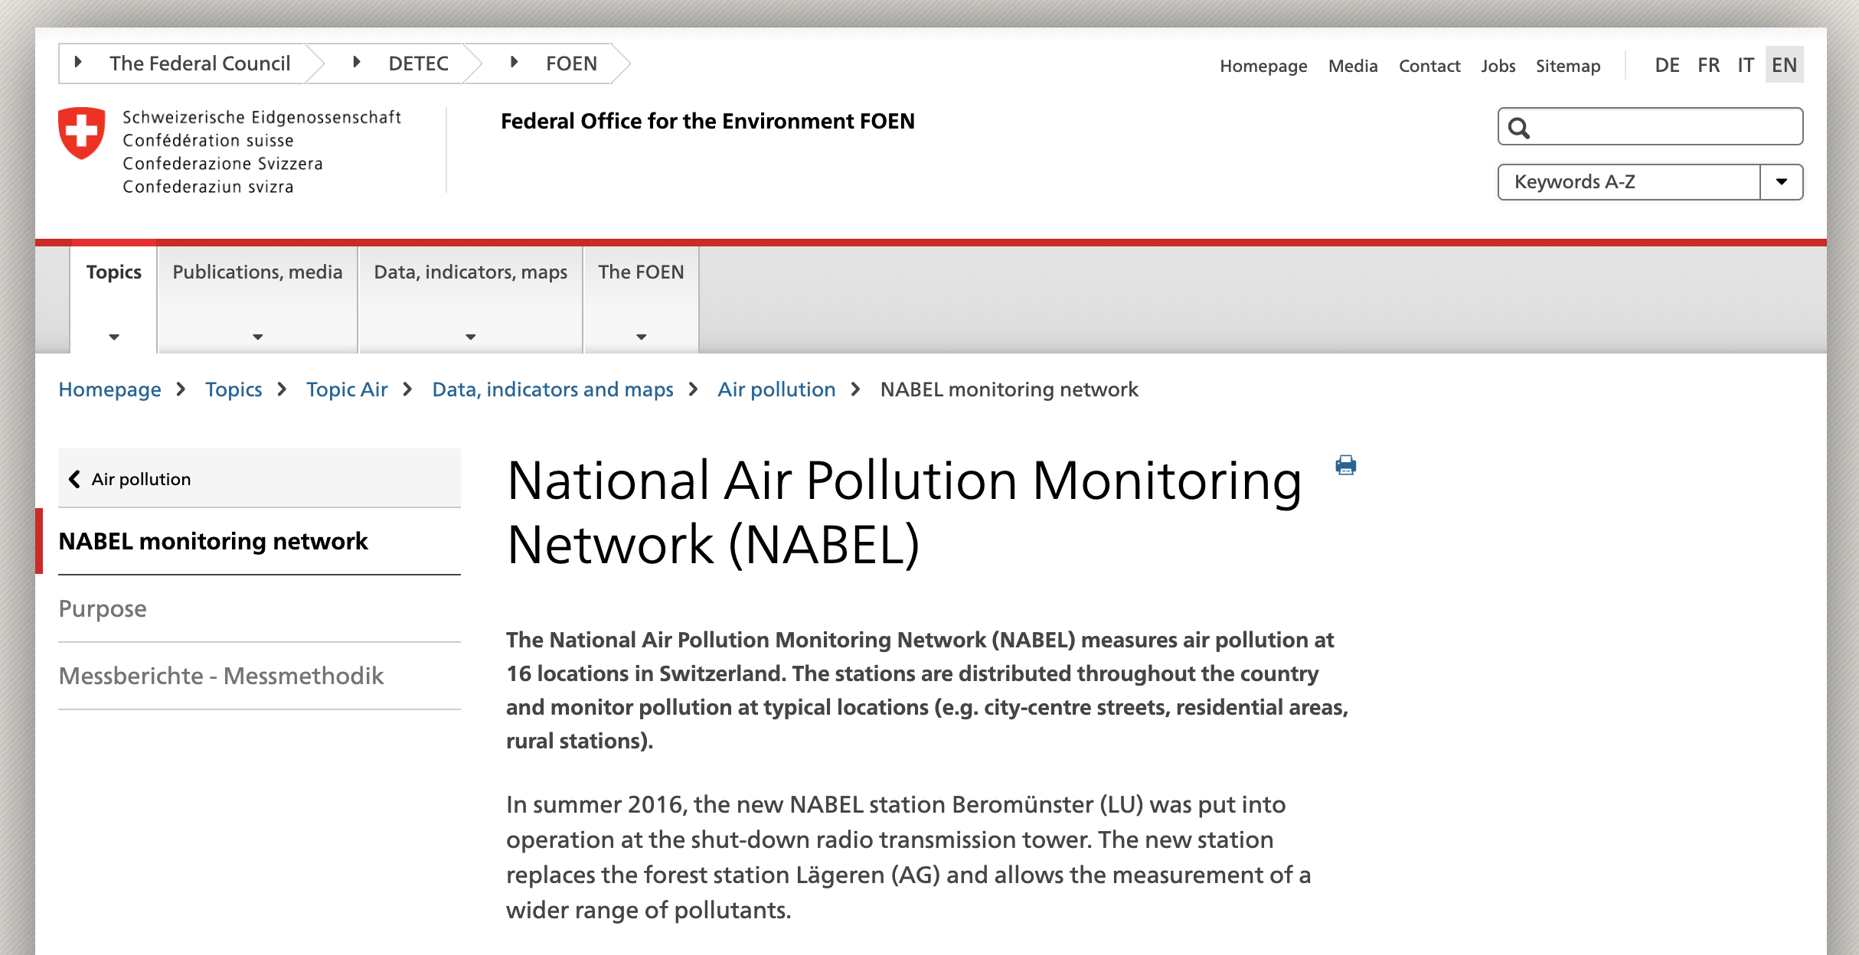
Issues with the Initial Data Pipeline
Only 6 days of measurements, so ~1’500 measurements
Get a new Raspberry ? Not enough time
Use public data
National Air Pollution Monitoring Network
1 measurement every hour
In a few big cities of Switzerland
First strategy : Get the same amount of data samples from NABEL so that we have the initially planned number of collected data
Bad strategy → Not the same time intervals (5 minutes vs. 1 hour)

Slide 6
2. Data Visualization

Slide 7
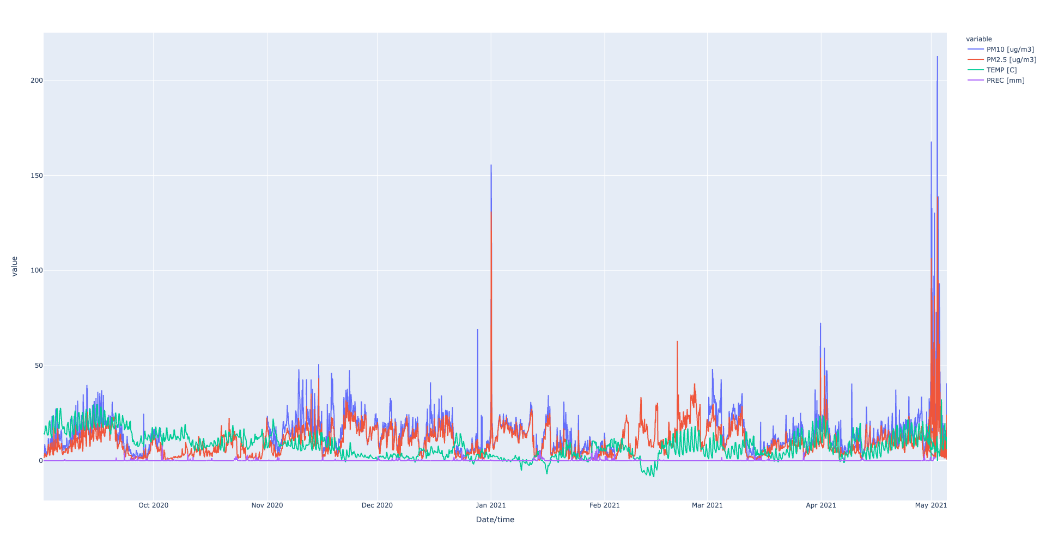
Dataset Visualization

Slide 8
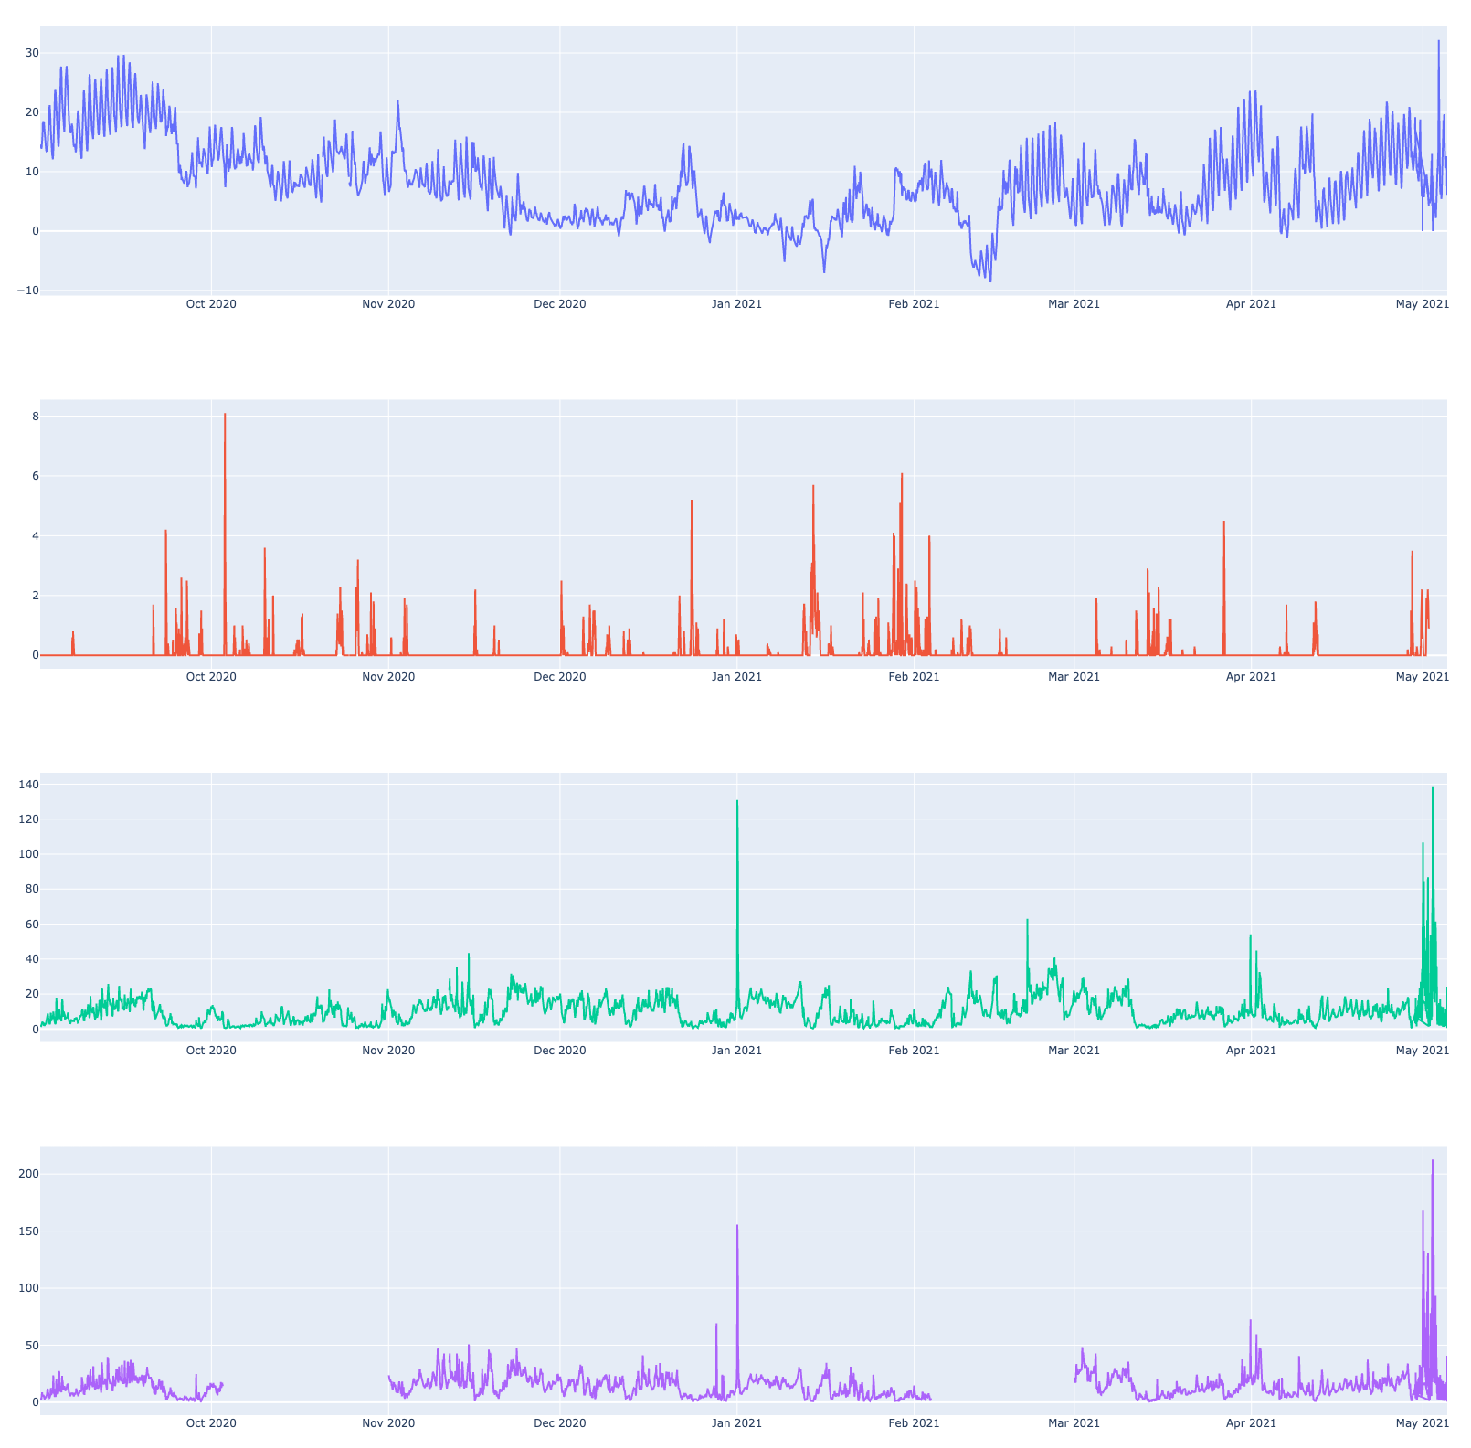
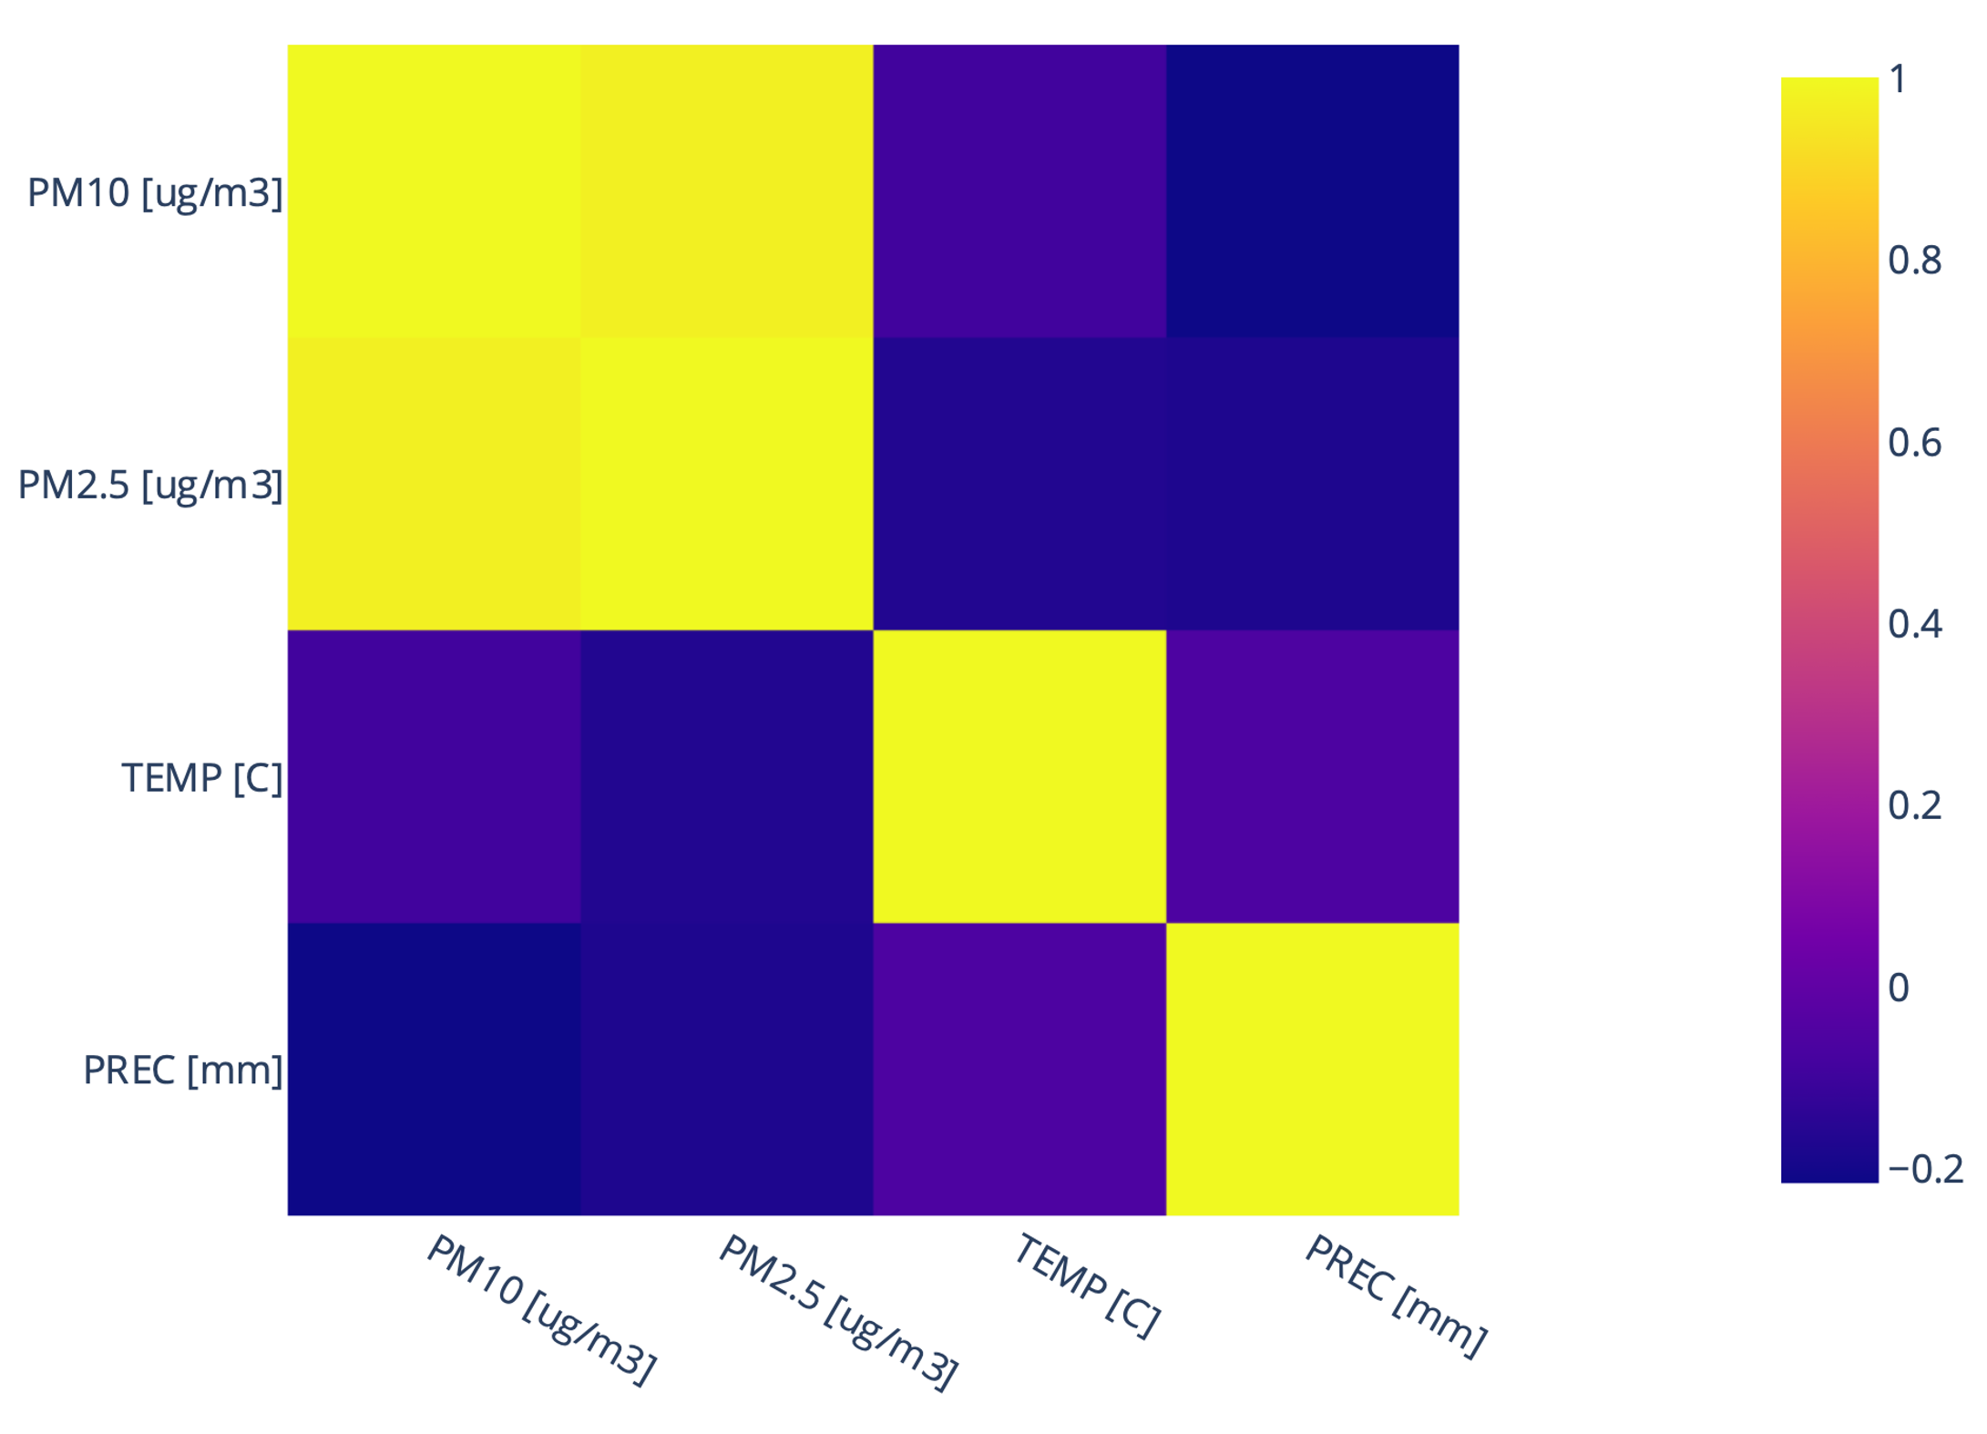
Temperature (in °C)
Variables Visualization
We first merged our two sources of data
But not great since the time intervals between two measurements are different
There are also a lot of missing values
Precipitation (in mm)
Correlogram of the dataset and its variables
PM2.5 (in µg/m3)
PM10 (in µg/m3)
Missing values

Slide 9
3. Data Preprocessing

Slide 10
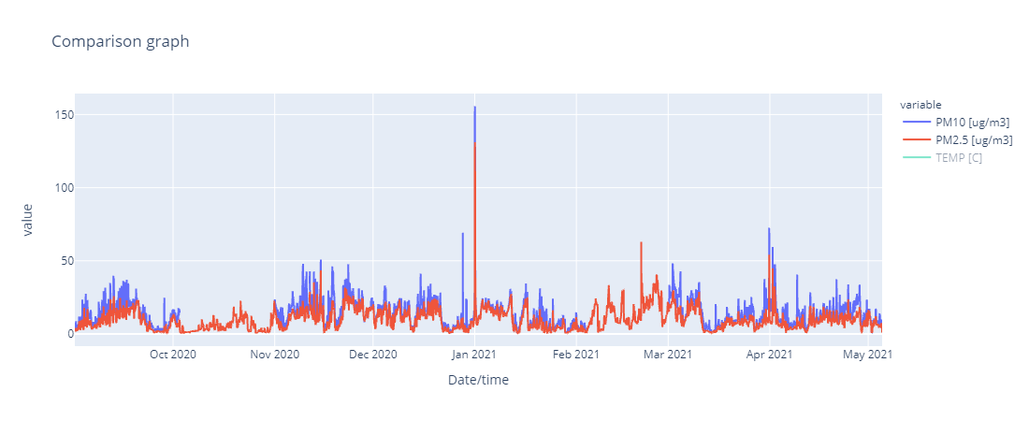
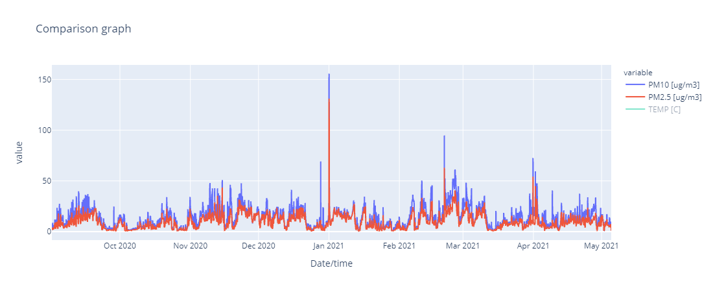
Imputation of Large Missing Data Intervals
Dynamic Time Warping (DTW) had bad results in finding similarities between the two curves
However, the high correlation (0.93) between PM10 and PM2.5 indicates strong similitudes between the two variables
We interpolated the larges missing gaps linearly, by multiplying PM2.5 by the average of PM10/PM2.5
It increased the correlation by a small value, but we consider it still coherent (0.95)

Slide 11
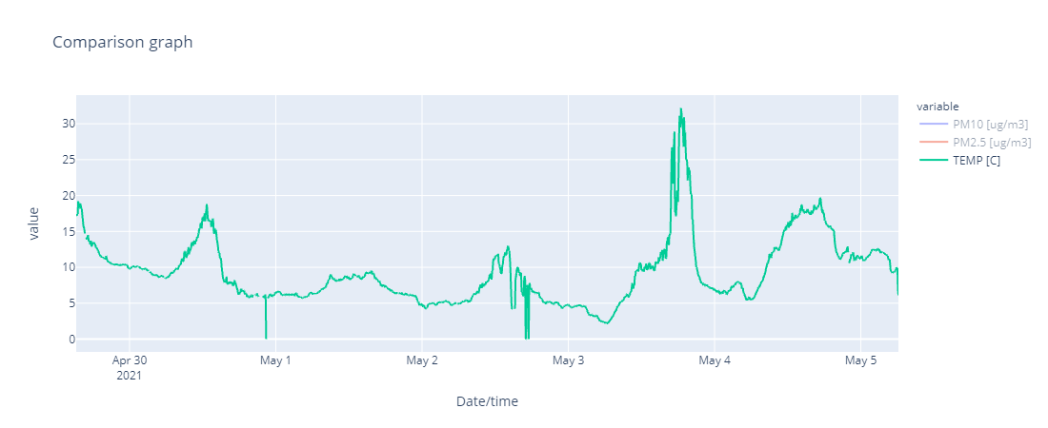
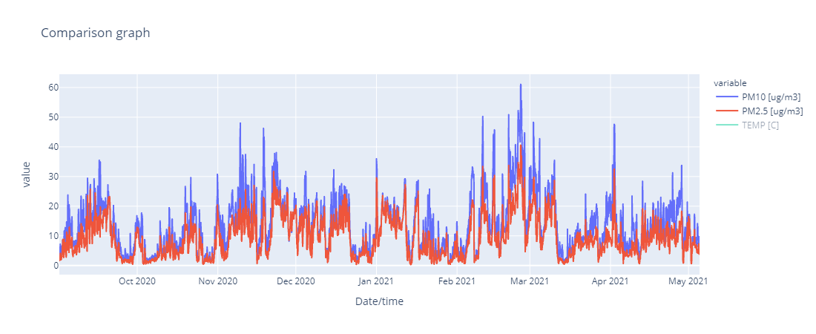
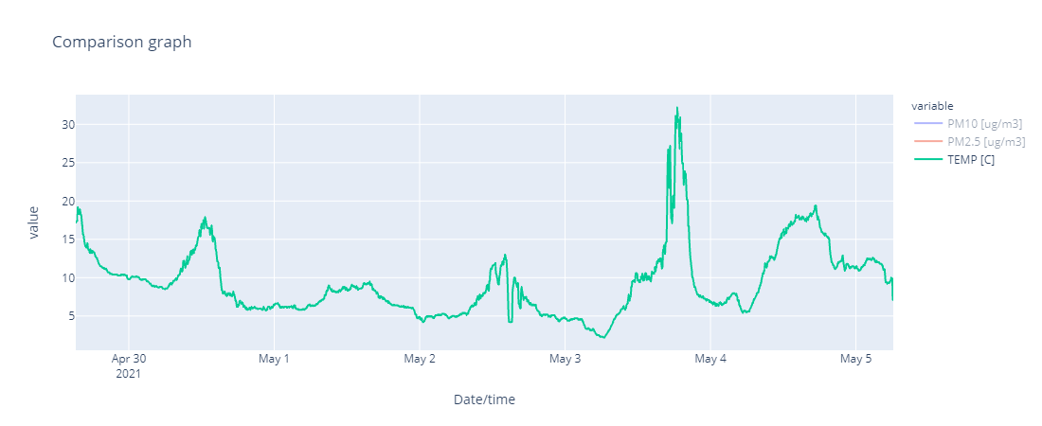
Removal of Outliers
Outliers are detected using Standard Deviation on a sliding window
If the Absolute Deviation of the sample divided by the Standard Deviation of the interval is above a chosen threshold, the outlier is removed and then linearly interpolated
This method has given good results, but may be slightly improved by using the median instead of the mean because it is less influenced by the outliers

Slide 12
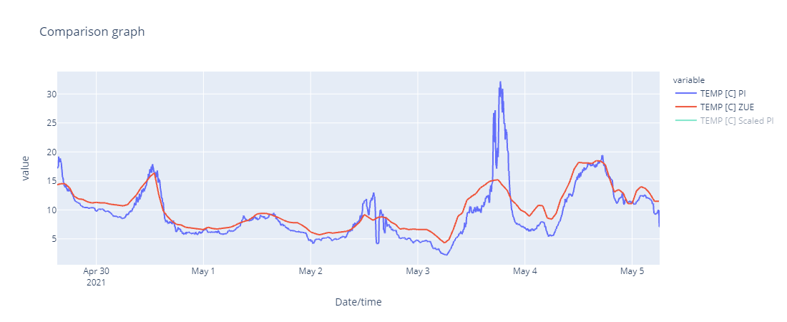
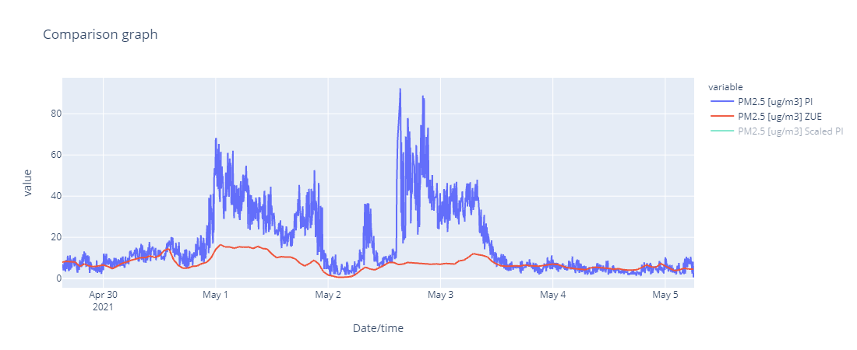
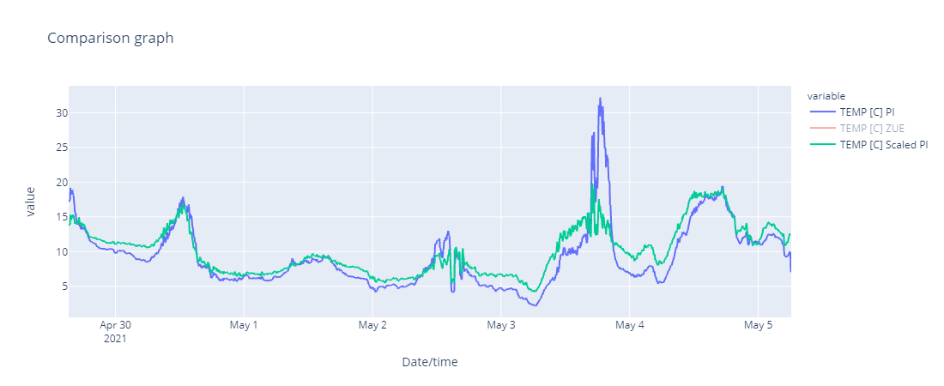
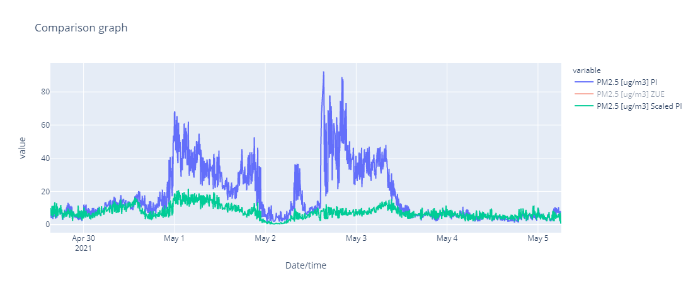
Rescaling the Raspberry Pi Data Using the NABEL Mean
In order to create coherence between our measured data and the NABEL data, we rescale the Raspberry Pi measures with respect to the NABEL data, which corresponds to means on a 1-hour interval

Slide 13
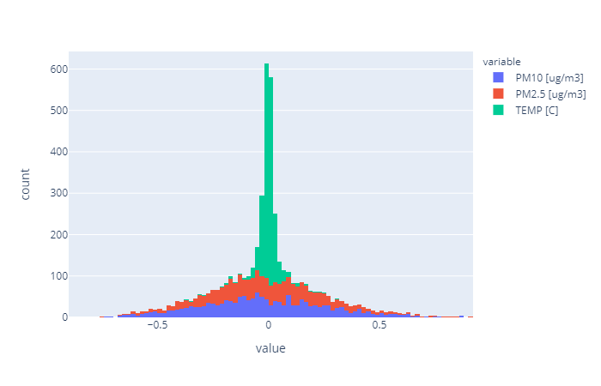
Adding Raspberry Pi Noise to the NABEL Data
We compute the variation of the rescaled Raspberry Pi noise around the NABEL Data
The variation at each point is divided by the NABEL value at this point to compute a proportional deviation
This proportional deviation takes the form of a Multivariate Gaussian Distribution, with PM10 and PM2.5 noise being strongly correlated
We then added random noise with the same distribution to the NABEL Data for which we did not have corresponding Raspberry Pi Data
The correlation between PM10 and PM2.5 after noising is 0.92, very close to our original correlation of 0.93

Slide 14
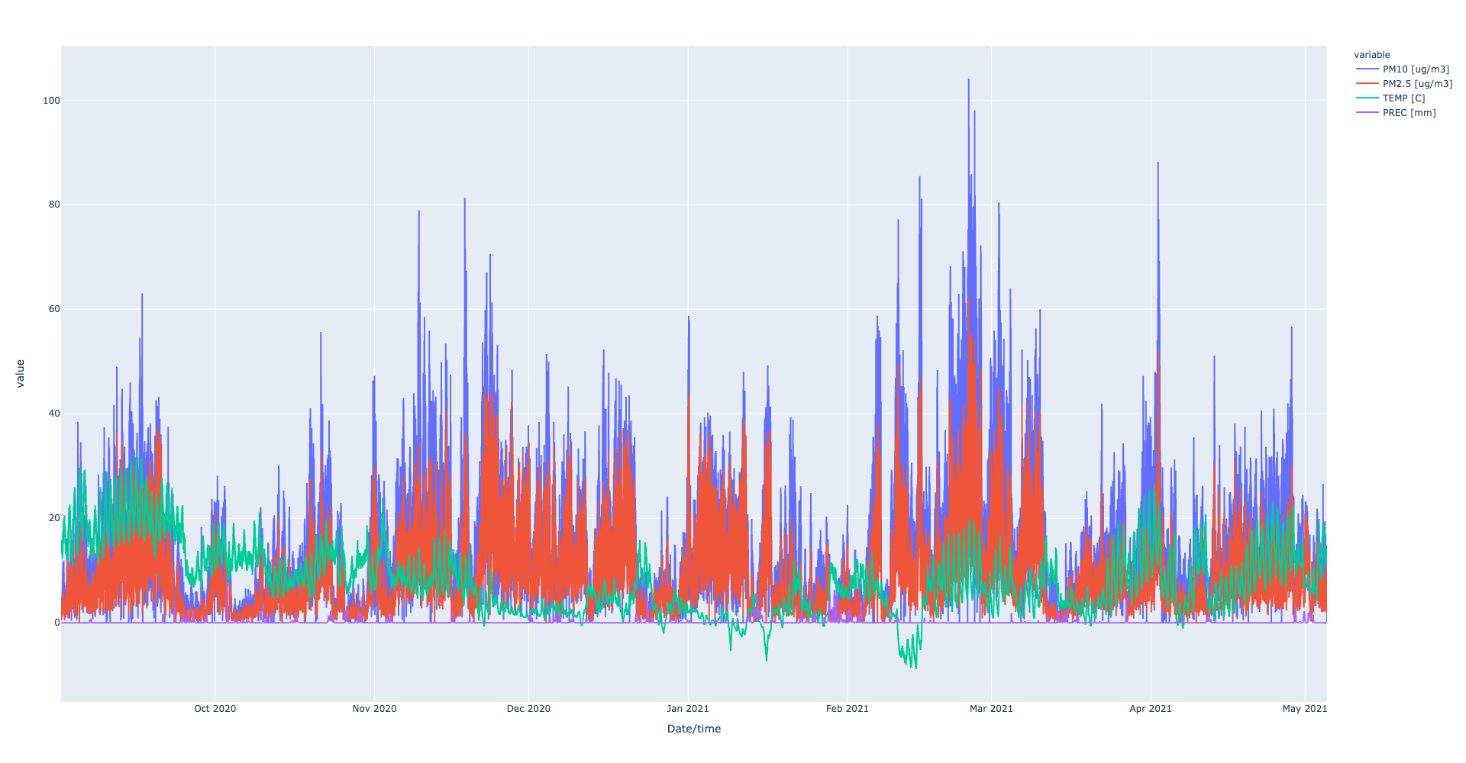
Imputed Dataset Visualization

Slide 15
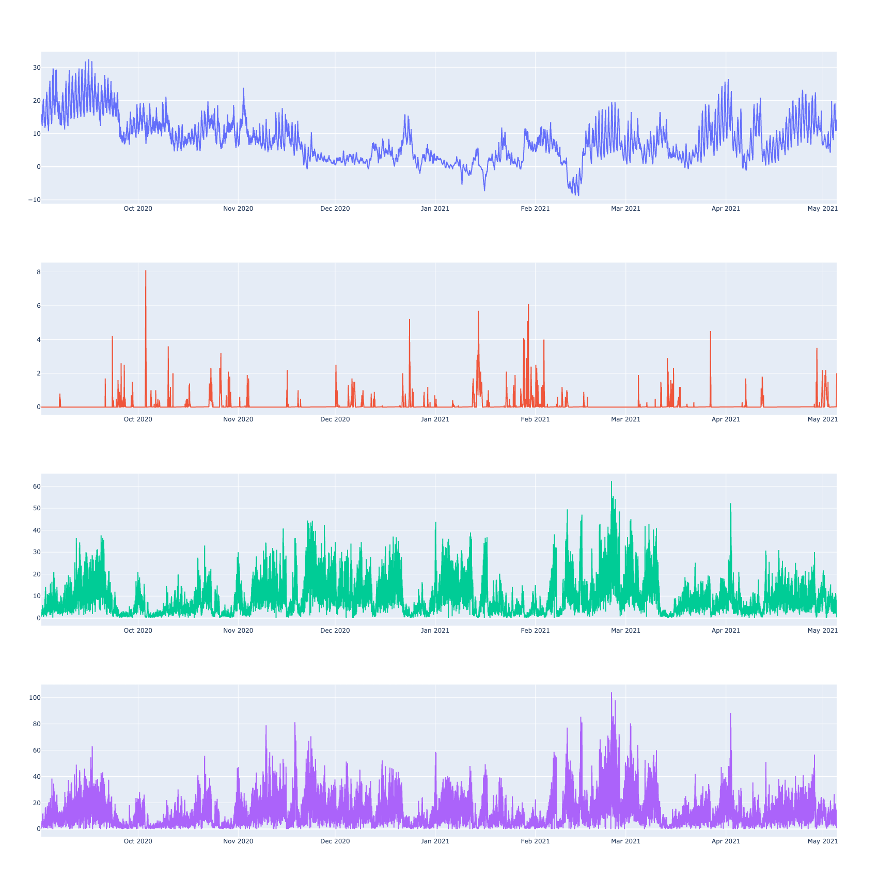
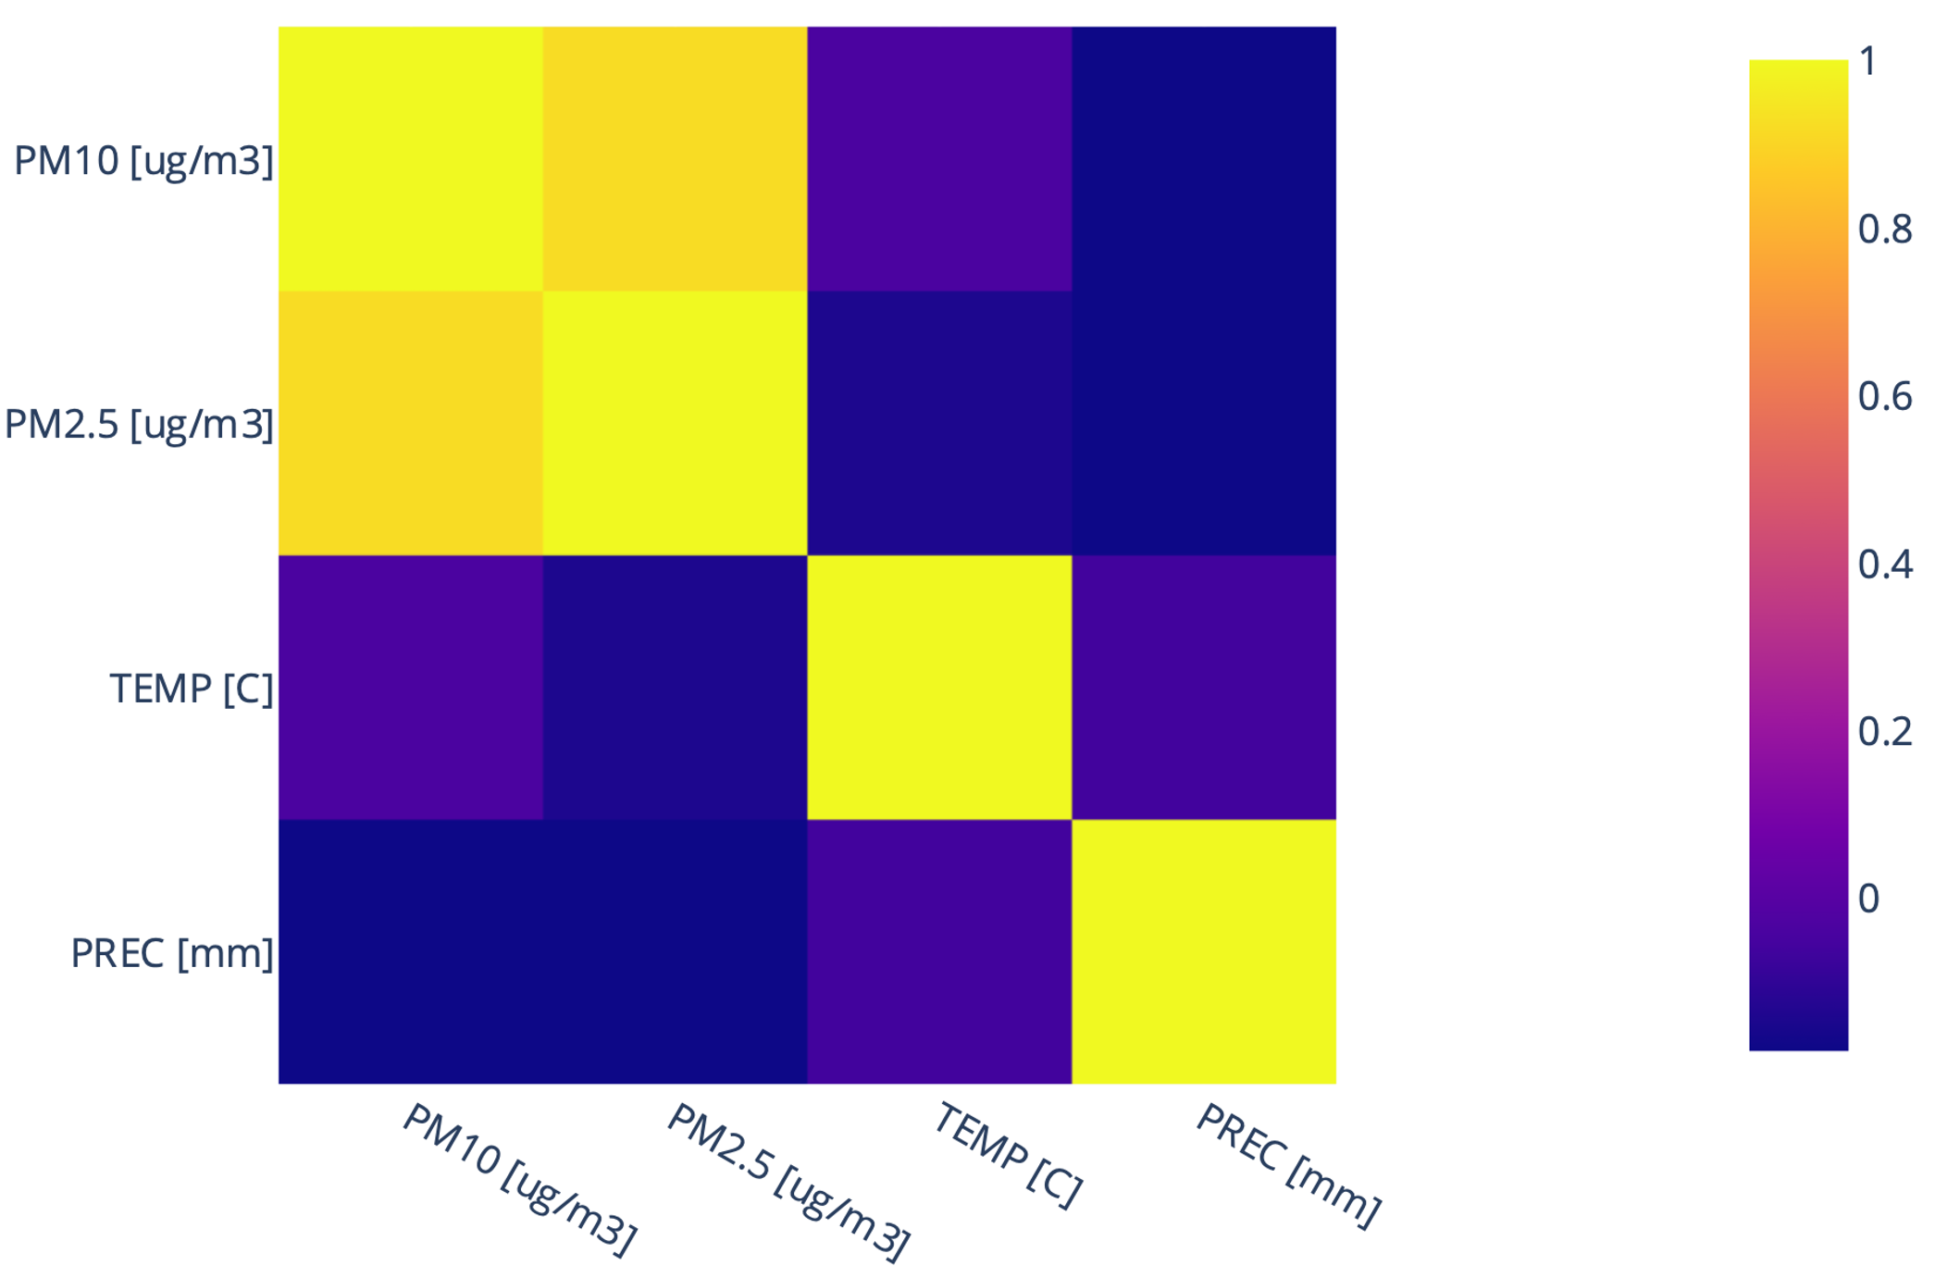
Temperature (in °C)
Imputed Dataset Visualization
Precipitation (in mm)
Correlogram of the imputed dataset and its variables
PM2.5 (in µg/m3)
PM10 (in µg/m3)

Slide 16
Comparison with the Non-Preprocessed Dataset
Temperature (in °C)
Temperature (in °C)
Precipitation (in mm)
Precipitation (in mm)
PM2.5 (in µg/m3)
PM2.5 (in µg/m3)
PM10 (in µg/m3)
PM10 (in µg/m3)

Slide 17
4. Forecasting PM2.5 Time-Series Using a Recurrent Neural Network (RNN)

Slide 18
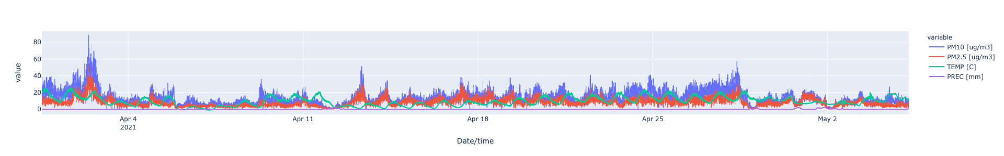
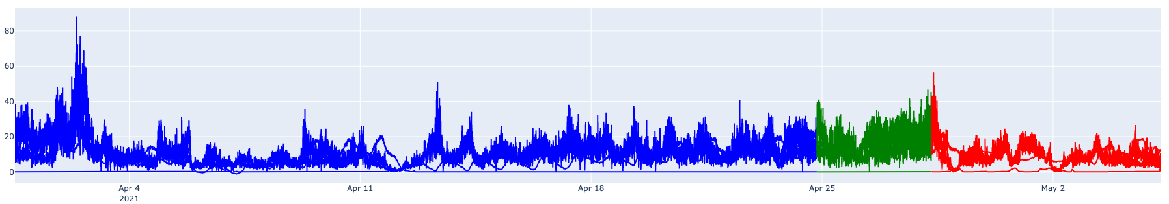
Reducing the Dataset
Our data after the pre-processing represents only ~2% of the dataset
As only ~1’600 of the data comes from our measurements, we wanted it to be included in both validation and testing of our dataset
For this purpose, we decided to take only the last 10’000 data samples to get the train-validation-test split of our data
We divided the reduced dataset as follows : 70% for training, 10% for validation and 20% for testing
Train set
Validation set
Test set

Slide 19
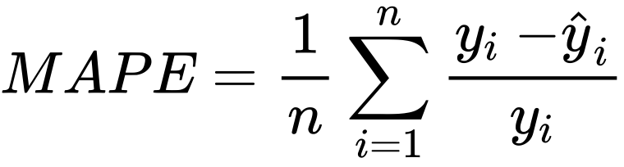
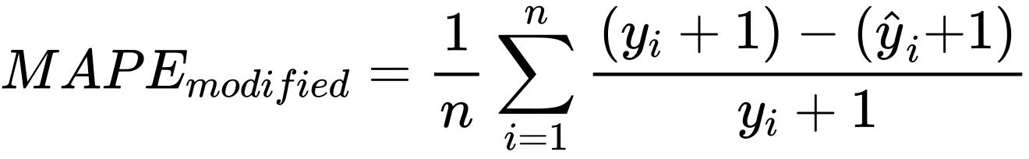
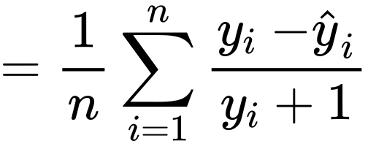
Long Short-Term Memory (LSTM)
Error metric :
Note: This error metric cannot use actual values equal to 0
To prevent this, we decided to add 1 to each value, turning into this formula instead:
Best number of epochs : 10
Best number of neurons in the input layer : 200
MAPE (in %) |  | Number of neurons in the input layer
 |  | 1 | 2 | 10 | 25 | 50 | 100 | 150 | 200
Number of iterations (epochs) | 1 | 51.43 | 46.65 | 72.70 | 81.14 | 82.53 | 68.70 | 58.91 | 57.50
 | 2 | 81.67 | 70.60 | 83.88 | 76.09 | 61.83 | 53.43 | 47.08 | 43.84
 | 10 | 86.17 | 63.66 | 42.62 | 40.41 | 38.26 | 35.50 | 35.02 | 33.79
 | 25 | 49.33 | 38.32 | 39.41 | 38.17 | 36.30 | 36.10 | 35.22 | 35.08
 | 50 | 37.75 | 38.69 | 38.50 | 36.84 | 35.68 | 35.64 | 35.59 | 35.36
 | 100 | 36.71 | 36.31 | 35.77 | 35.32 | 35.41 | 35.43 | 35.45 | 35.69
 | 150 | 36.67 | 35.23 | 36.48 | 35.64 | 35.52 | 35.65 | 35.81 | 35.86
 | 200 | 35.56 | 35.60 | 34.41 | 35.27 | 35.17 | 35.39 | 35.64 | 35.73

Slide 20
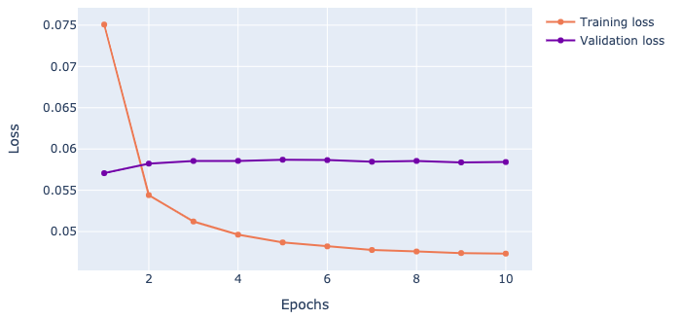
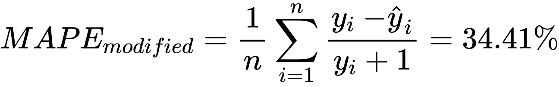
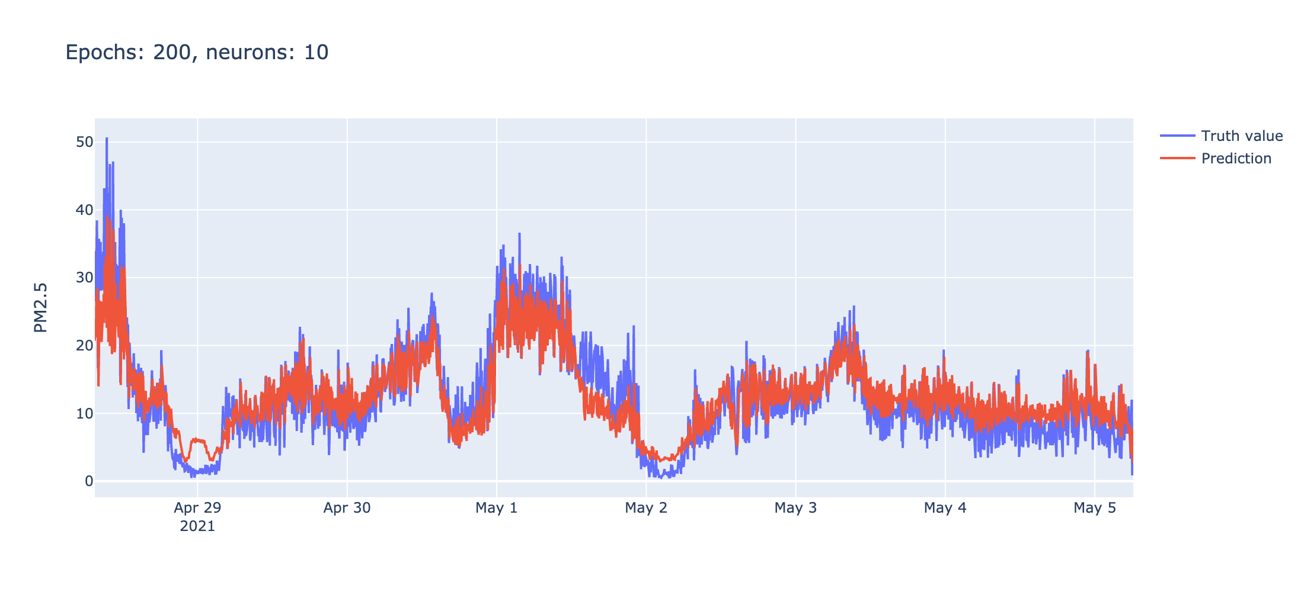
Best Tested Parameters for RNN-LSTM
Number of epochs : 10
Number of neurons in the input layer : 200
Error percentage :
The prediction is performed on the test set after the model has been trained using training and validation sets

Slide 21
5. Comparison of Our Model with Other Time-Series Forecasting Methods
a. Data Prediction using Fast Fourier Transform

Slide 22
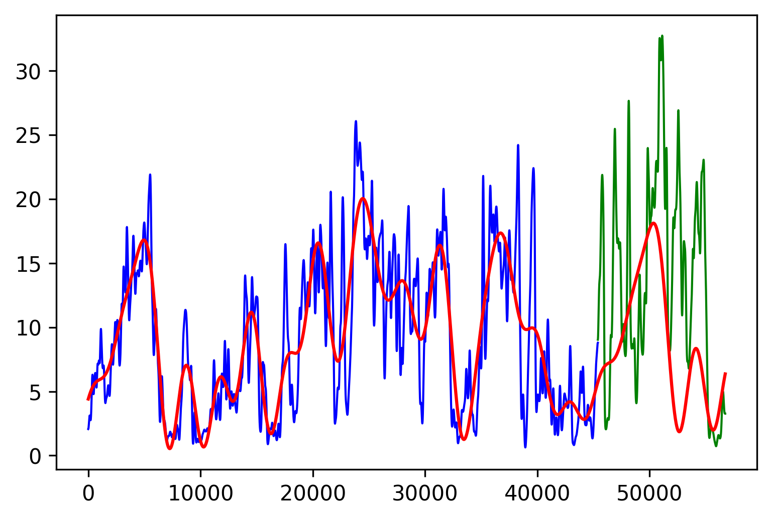
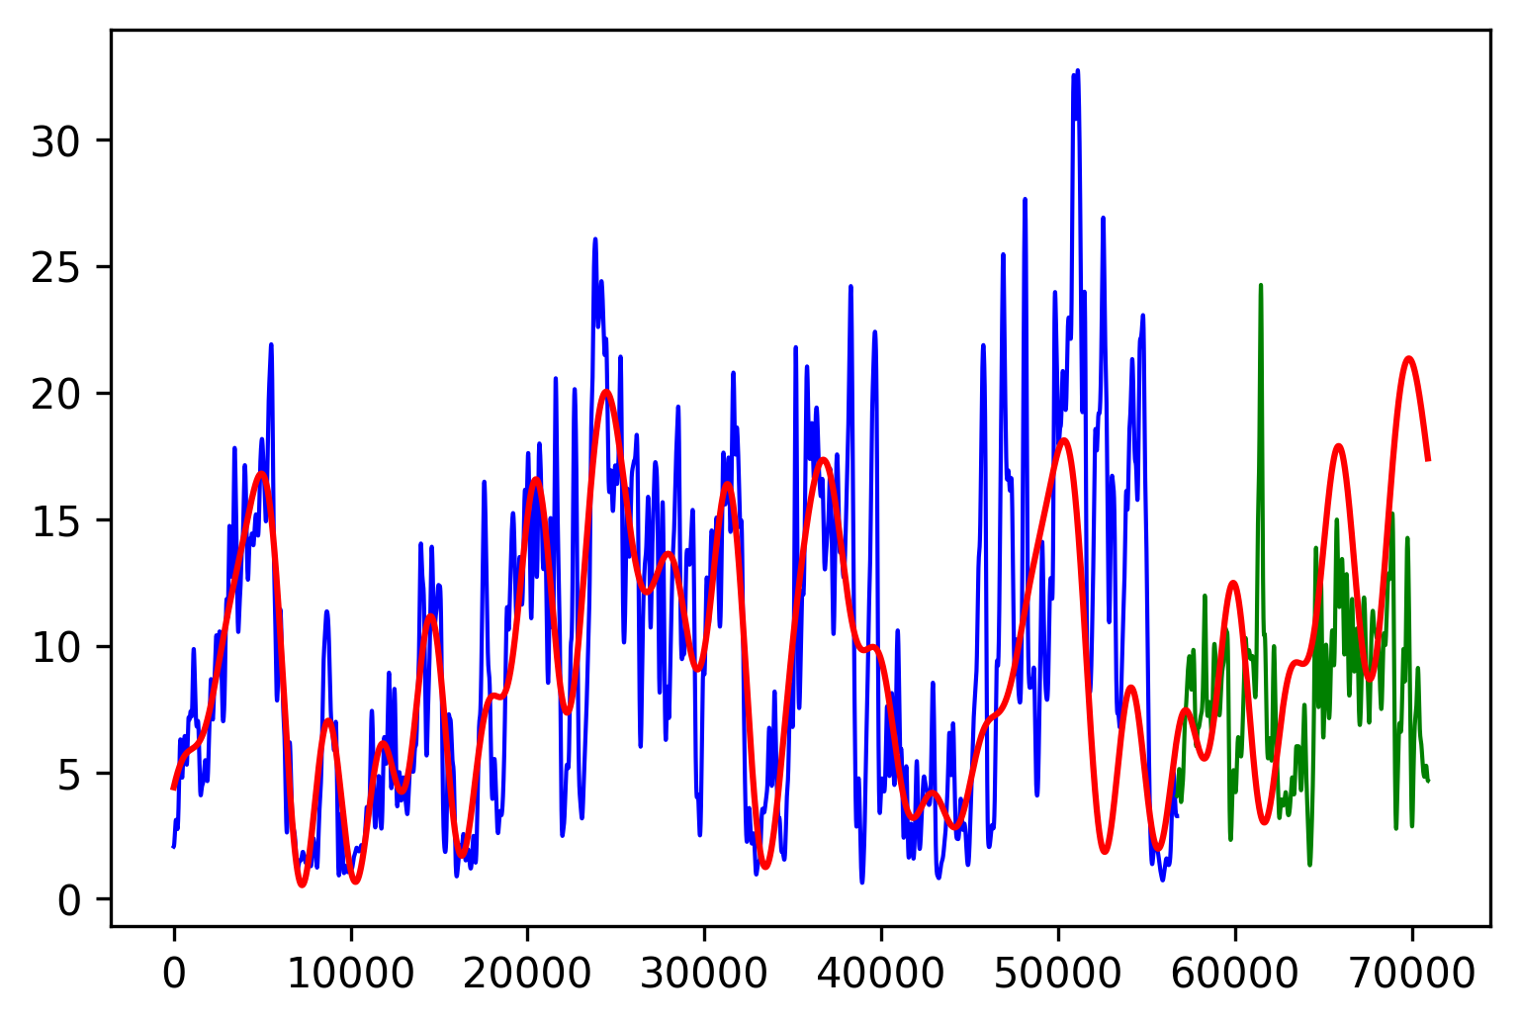
Data Prediction with FFT
Best Validation Loss - 58.74
Test Loss - 91.37
We ran a cross-validation to find the optimal split between training and validation sets and the best "blurring" parameter, with MAPE Loss to compare it with the other models we trained

Slide 23
5. Comparison of Our Model with Other Time-Series Forecasting Methods
b. Data Prediction using Facebook Prophet

Slide 24
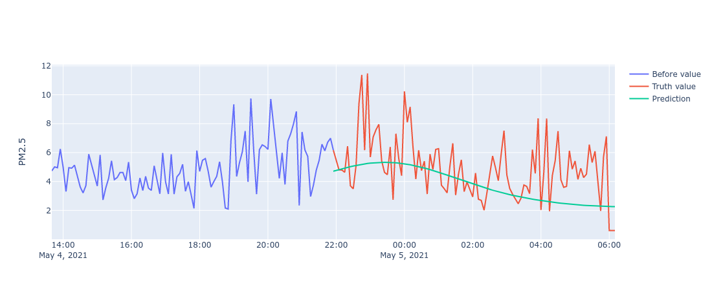

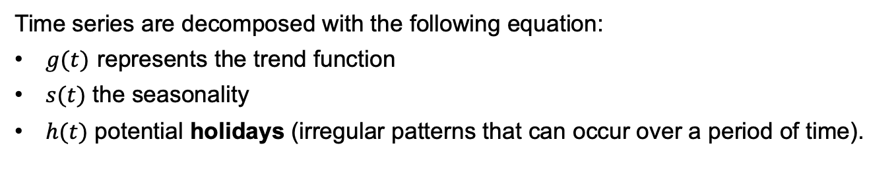
Data Prediction with Facebook Prophet
The Facebook Prophet model is for forecasting time series data based on an additive model where non-linear trends are fit with seasonality.
Time series are decomposed with the following equation:
$g(t)$ represents the trend function
$s(t)$ the seasonality
$h(t)$ potential holidays (irregular patterns that can occur over a period of time).

Slide 25
5. Comparison of Our Model with Other Time-Series Forecasting Methods
c. Data Prediction using SARIMAX

Slide 26
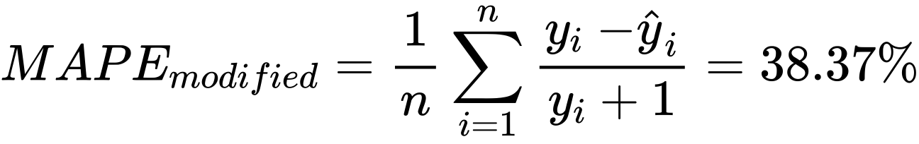
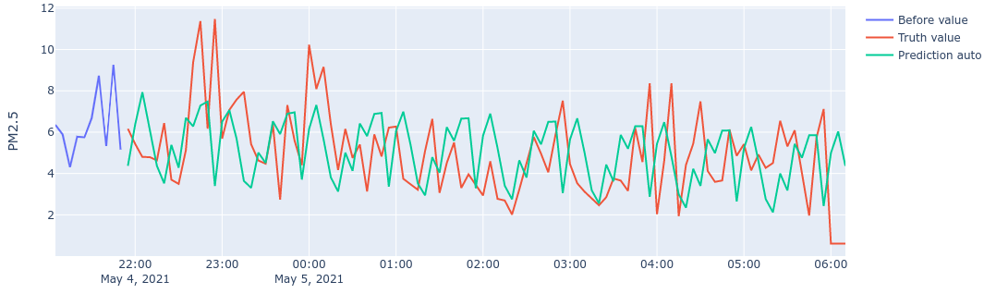
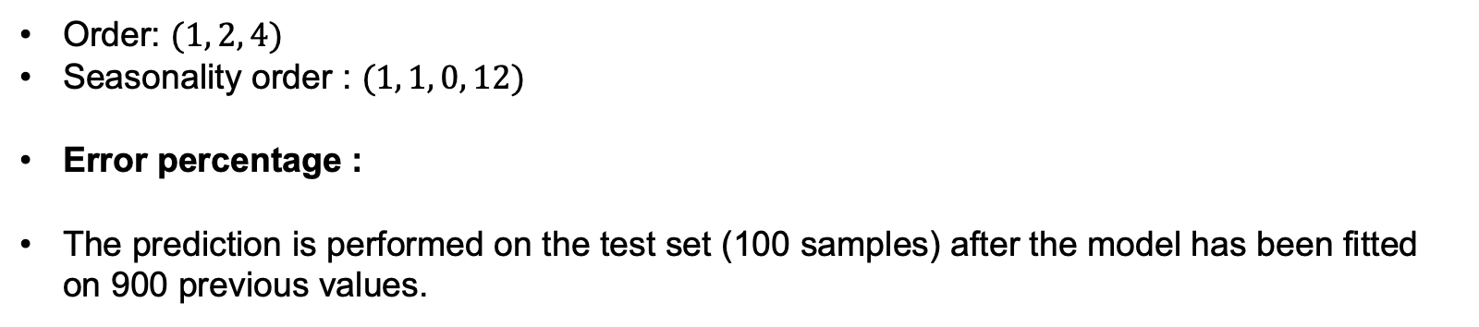
Best Tested Parameters for SARIMA
Order: $(1, 2, 4)$
Seasonality order : $(1, 1, 0, 12)$
Error percentage :
The prediction is performed on the test set (100 samples) after the model has been fitted on 900 previous values.

Slide 27
6. Conclusion

Slide 28
Conclusion
The data must be gathered and used carefully
The quality of the data has a lot of influence on the quality of the models
Bad data → (likely) bad results with a good model
Measured data can be quite different from the reality, due to among others:
Cheap hardware, which might give not very precise measurement
Sensors are put in places that are not 100% representative of the overall weather conditions (too exposed to the sun, too exposed to humidity…)
Error was never below 34% for LSTM, which is still quite good but not totally reliable
100% accuracy is not possible when predicting air quality

Slide 29
One Last Example

Slide 30
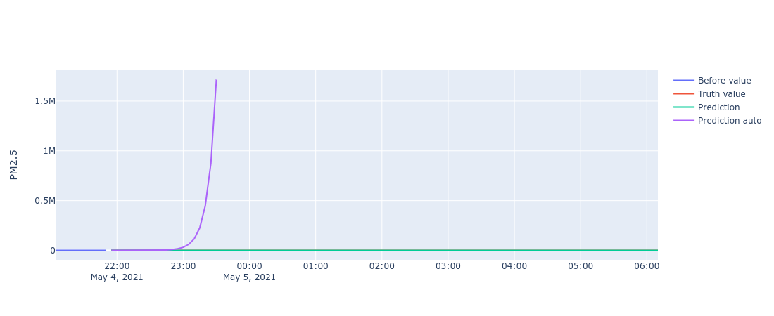
End of the World on May 4th
(Wrongly) Training models can lead to surprising results…

Slide 31
References
J. Brownlee, Multivariate Time Series Forecasting with LSTMs with Keras, Machine Learning Mystery, 2017 (link)
S. J. Taylor, B. Letham, Forecasting at Scale, Facebook Open Source, (link) (paper)
R. C. Staudemeyer, E. Rothstein Morris, Understanding LSTM -- a tutorial into Long Short-Term Memory Recurrent Neural Networks, 2019 (link)

Slide 32
Thank you for your attention!
And a special thank you to Sachit whose help dealing with the Raspberry issues was really appreciated and useful

